Slide 1
Software Process Model

Slide 2
Software Process
For success in large Software development, it is important to follow an engineering approach, consisting of a well-defined process.
Process consists of activities/steps to be carried out in a particular order.
Software process deals with both technical & management issues.
Consists of different types of process

Slide 3
Process Types…
Process for Software development:
Produces Software as result.
Multiple such processes may exist.
A project follows a particular process.
Process for managing the project :
Defines project planning & control.
Effect estimates made & schedule prepared.
Resources provided.
Feedback taken for quality assurance.
Monitoring done.
Process for managing the above processes themselves:
Improving the processes based on new techniques, tools etc.
Standardizations & certification(ISO,CMM)

Slide 4
Multiple Processes
A large development company may have multiple development processes.
For client server based conventional application(sales processing, payroll).
For enterprise-level project based on packages & customization
For web-based e-commerce Type
For data warehousing/decision type.
Company may have many projects in each category.

Slide 5
Steps in Process
Each step has a well-defined objective
Requires people with specific skills.
Uses specific techniques, tools, guidelines.
Takes specific inputs & produces well defined output.
Step define when it may begin(Entry criteria) & when it ends(exit criteria)
Step must be executed as per project plan that gives duration, effort, resource, constrains.
It must produce information for management so that corrective action can be taken.
E.g. adding more resources.
A step ends in a review(V &V)
Verification :
Check consistency of outputs with inputs(of the step)
Validation:
Check consistency with user needs.

Slide 6
Process Steps
Entry Criteria
Action to be carried out
Review V & V
Exit
Criteria
Information for Management
Project Control Information

Slide 7
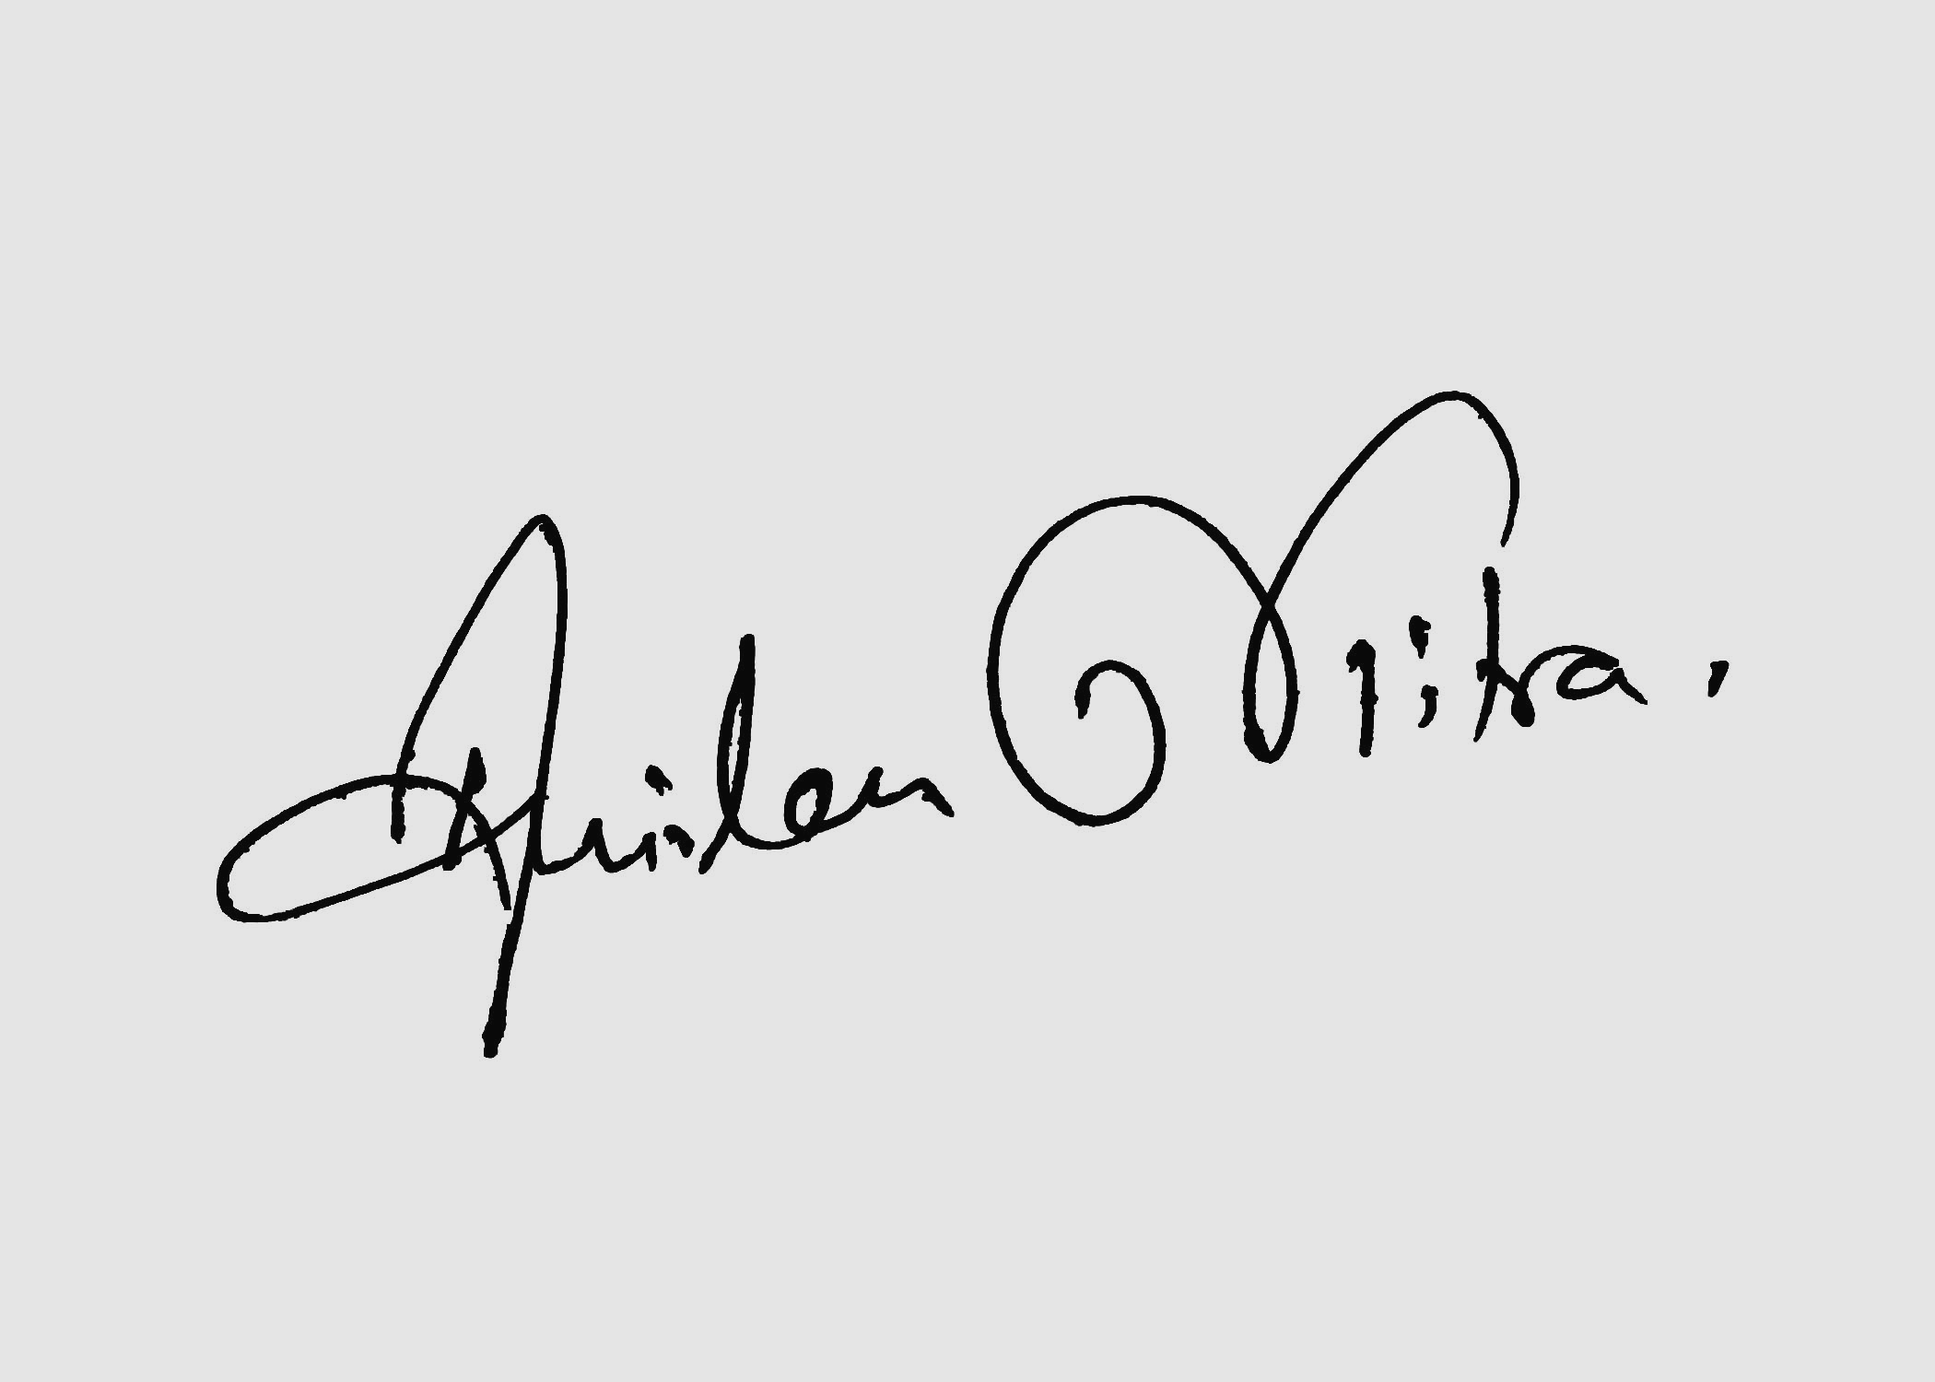
Characteristics of a Good Proecss
Should be precisely defined-:
No ambiguity about what is to be done ,when,how,etc.
It must be predictable-
Can be repeated in other projects with confidence about its outcome
Predictable with respect to effort,cost
Predictable for quality with respect to number and type of defects performance.

Slide 8
Characteristics of a Good Proecss..
Predictable process is said to be “under Statistical control” where actual values are close to expected values.
It supports testing & maintainability
Maintenance by third party.
Follow standard, provide necessary documentation
This characteristic differentiates between prototype & product
Facilitates early detection of and removal of defects.
Defect add to project cost.
Late detection & correction is costly
It should facilitate monitoring & improvement
Based on feedback
Permit use of new tools, technology
Permit measurements

Slide 9
Waterfall Model for development
System Eng
Analysis Project Planning
DEsign
Coding
Testing/Integration
Installation .Maintainance

Slide 10
Try to understand the overall problem what type of responsibllity have to be carried out by the software
Undersatnd problem domain/Data Structure
System Eng
Analysis Project Planning
DEsign
Coding
High level Design,Translate the rquirment into software Arc
Testing/Integration
Installation .Maintainance

Slide 11
Classical Waterfall Model
Classical waterfall model divides life cycle into phases:
feasibility study,
requirements analysis and specification,
design,
coding and unit testing,
integration and system testing,
maintenance.

Slide 12
Classical Waterfall Model
Feasibility Study
Req. Analysis
Design
Coding
Testing
Maintenance

Slide 13
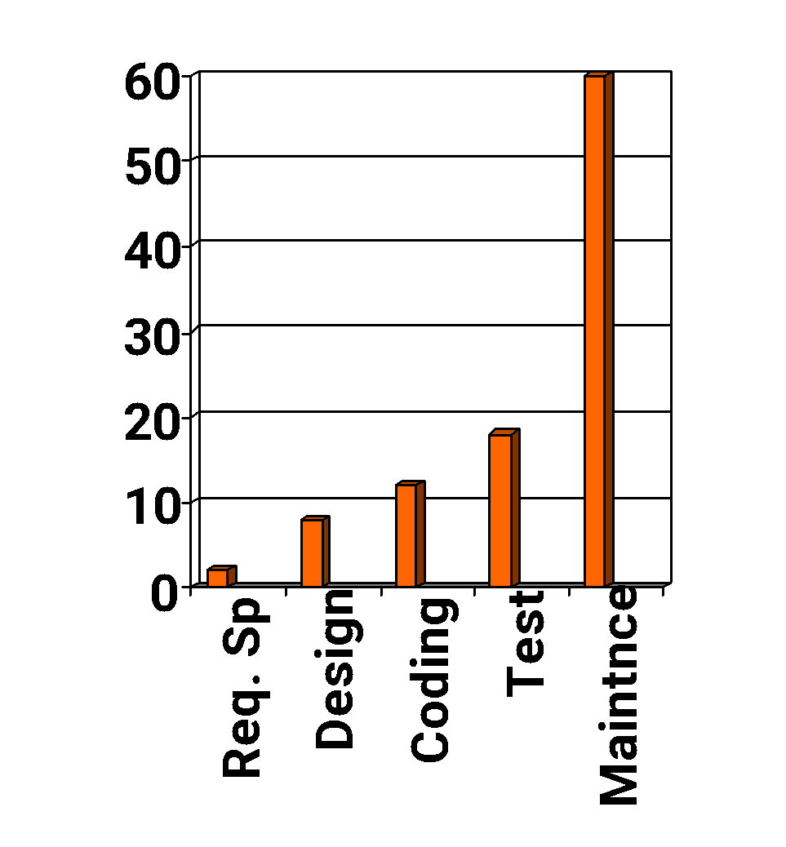
Relative Effort for Phases
Phases from requirement specification to testing
known as development phases.
Among all life cycle phases
maintenance phase consumes maximum effort.
Among development phases,
testing phase consumes the maximum effort.
Relative Effort

Slide 14
Classical Waterfall Model (CONT.)
Most organizations usually define:
standards on the outputs (deliverables) produced at the end of every phase
entry and exit criteria for every phase.
They also prescribe specific methodologies for:
specification,
design,
coding,
testing, etc.

Slide 15
Feasibility Study
Main aim of feasibility study: determine whether developing the product
financially worthwhile
technically feasible.
Types of Feasibility study:
Technical Feasibility,
Operational Feasibility,
Economic Feasibility.

Slide 16
TECHNICAL Feasibility
Checks whether the required resources to develop the system can be accessed within the allocated time and budget.

Slide 17
OPERATIONAL Feasibility
Checks whether the new system performs all the intended operations.

Slide 18
ECONOMICAL Feasibility
Determines whether the required system is capable of generating financial gains for the organization.

Slide 19
Requirements Analysis and Specification
Aim of this phase:
understand the exact requirements of the customer,
document them properly.
Consists of two distinct activities:
requirements gathering and analysis
requirements specification.

Slide 20
Requirements Gathering
Gathering relevant data:
usually collected from the end-users through interviews and discussions.
For example, for a business accounting software:
interview all the accountants of the organization to find out their requirements.

Slide 21
Requirements Analysis (CONT.)
The data you initially collect from the users:
would usually contain several contradictions and ambiguities:
each user typically has only a partial and incomplete view of the system.

Slide 22
Requirements Analysis (CONT.)
Collect all related data from the customer:
analyze the collected data to clearly understand what the customer wants,
find out any inconsistencies and incompleteness in the requirements,
resolve all inconsistencies and incompleteness.

Slide 23
Requirements Analysis (CONT.)
Ambiguities and contradictions:
must be identified
resolved by discussions with the customers.
Next, requirements are organized:
into a Software Requirements Specification (SRS) document.

Slide 24
Requirements Analysis (CONT.)
Engineers doing requirements analysis and specification:
are designated as analysts.

Slide 25
Design
Design phase transforms requirements specification:
into a form suitable for implementation in some programming language.

Slide 26
Design
In technical terms:
during design phase, software architecture is derived from the SRS document.
Two design approaches:
function oriented approach,
object oriented approach.

Slide 27
FUNCTION ORIENTED Design Approach
Consists of two activities:
Structured Analysis
Structured Design

Slide 28
Structured Analysis Activity
Identify all the functions to be performed.
1
Identify data flow among the functions.
2
Decompose each function recursively into sub-functions.
3
Identify data flow among the sub-functions as well.

Slide 29
Structured Analysis (CONT.)
Carried out using Data flow diagrams (DFDs).
After structured analysis, carry out structured design:
architectural design (or high-level design)
detailed design (or low-level design).

Slide 30
Structured Design
High-level design:
decompose the system into modules,
represent invocation relationships among the modules.
Detailed design:
different modules designed in greater detail:
data structures and algorithms for each module are designed.

Slide 31
Object Oriented Design
First identify various objects (real world entities) occurring in the problem:
identify the relationships among the objects.
For example, the objects in a pay-roll software may be:
employees,
managers,
pay-roll register,
Departments, etc.

Slide 32
Implementation
Purpose of implementation phase (aka coding and unit testing phase):
translate software design into source code.

Slide 33
Implementation
During the implementation phase:
each module of the design is coded,
each module is unit tested
tested independently as a stand alone unit, and debugged,
each module is documented.

Slide 34
Implementation (CONT.)
The purpose of unit testing:
test whether individual modules work correctly.
The end product of implementation phase:
a set of program modules that have been tested individually.

Slide 35
Integration and System Testing
Different modules are integrated in a planned manner:
Modules should never integrate in one shot.
Normally integration is carried out through several steps.
During each integration step,
the partially integrated system is tested.

Slide 36
Integration and System Testing
M1
M2
M3
M4

Slide 37
System Testing
After all the modules have been successfully integrated and tested:
system testing is carried out.
Goal of system testing:
ensure that the developed system functions according to its requirements as specified in the SRS document.

Slide 38
Maintenance
Maintenance of any software product:
requires much more effort than the effort to develop the product itself.
development effort to maintenance effort is typically 40:60.

Slide 39
Maintenance (CONT.)
Corrective maintenance:
Correct errors which were not discovered during the product development phases.
Perfective maintenance:
Improve implementation of the system
enhance functionalities of the system.
Adaptive maintenance:
Port software to a new environment,
e.g. to a new computer or to a new operating system.

Slide 40
Deliverables in Waterfall Model
Project plan & feasibilty Report: Cost & time
Requirement document:SRS
System Design Document
Detailed Design Document
Test plans & test Report
Source Cose : EXE form
Software manuals:User Manual,Installation manual
Review Report

Slide 41
Shortcoming Of WM
Requirements may not be clearly known, Especially for applications not having existing counterpart
Railway reservation: Manual system existed, so SRS can Be defined
On-line container management for railways
Knowledge management for central bank
Requirement change with time during project life cycle itself…

Slide 42
Shortcoming Of WM…
Requirement change with time during project life cycle itself…
User may find solution of little use
Better to develop in parts in smaller increments
This is common for packages, System software
Consider documentation heavy: so much documentation may not be required for all types of project.

Slide 43
Iterative Waterfall Model
Classical waterfall model is idealistic:
assumes that no defect is introduced during any development activity.
in practice:
defects get introduced in almost every phase of the life cycle.

Slide 44
Iterative Waterfall Model (CONT.)
Defects usually get detected much later in the life cycle:
For example, a design defect might go unnoticed till the coding or testing phase.

Slide 45
Iterative Waterfall Model (CONT.)
Once a defect is detected:
We need to go back to the phase where it was introduced
Redo some of the work done during that and all subsequent phases.
Therefore, we need feedback paths in the classical waterfall model.

Slide 46
Iterative Waterfall Model (CONT.)
Feasibility Study
Req. Analysis
Design
Coding
Testing
Maintenance

Slide 47
Iterative Waterfall Model (CONT.)
Errors should be detected
in the same phase in which they are introduced.
For example:
if a design problem is detected in the design phase itself,
the problem can be taken care of much more easily
than say if it is identified at the end of the integration and system testing phase.

Slide 48
Phase containment of errors
Reason: rework must be carried out not only to the design but also to code and test phases.
The principle of detecting errors as close to its point of introduction as possible:
is known as phase containment of errors.
Iterative waterfall model is by far the most widely used model.
Almost every other model is derived from the waterfall model.

Slide 49
Prototyping Model
Before starting actual development,
a working prototype of the system should first be built.
A prototype is a toy implementation of a system:
limited functional capabilities,
low reliability,
inefficient performance.

Slide 50
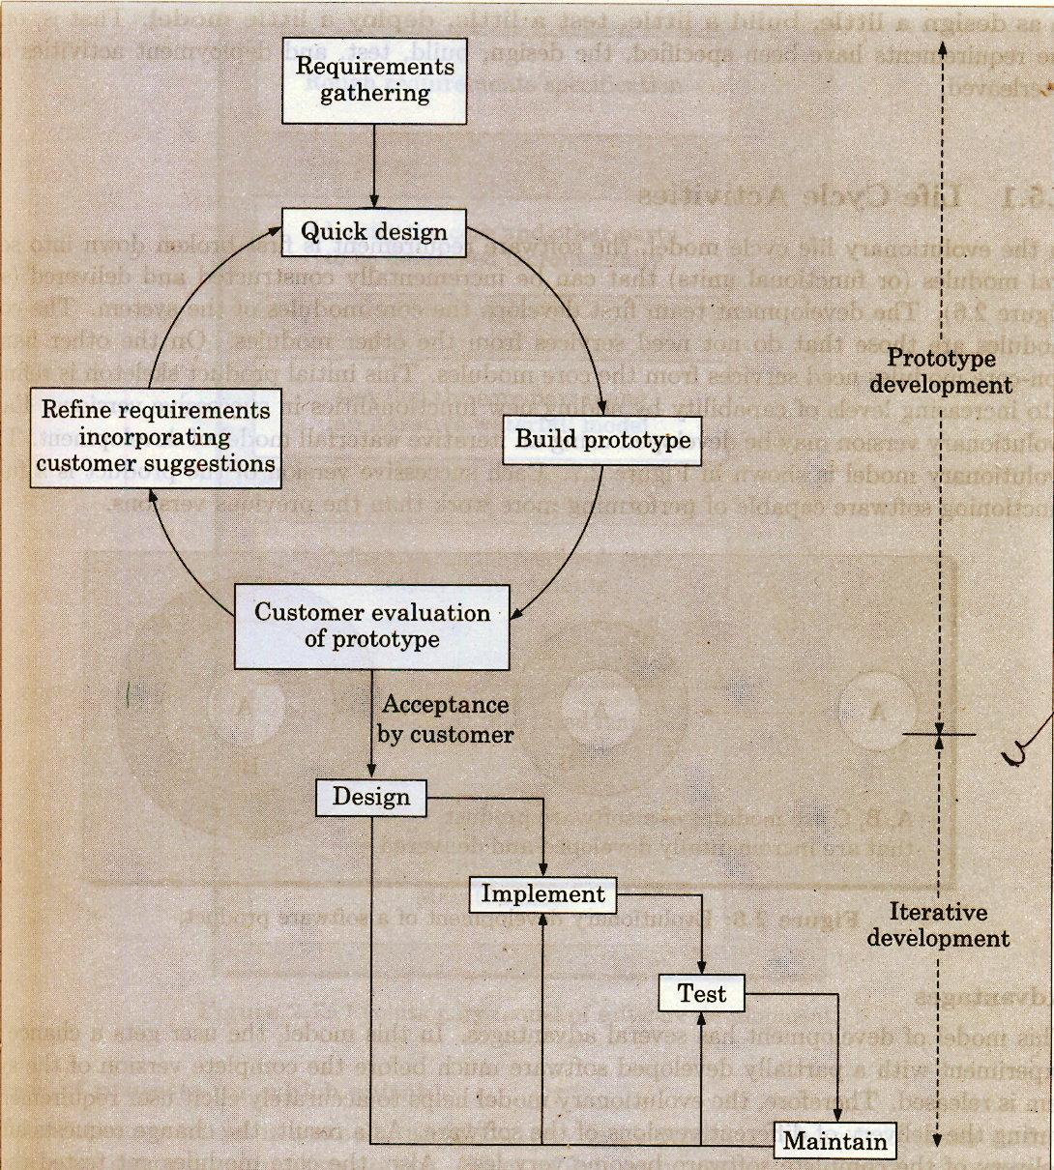

Slide 51
Reasons for developing a prototype
Illustrate to the customer:
Input data formats, messages, reports, or interactive dialogs.
All the requirements are not clear.

Slide 52
Prototyping Model (CONT.)
The third reason for developing a prototype is:
it is impossible to “get it right” the first time,
we must plan to throw away the first product
if we want to develop a good product.

Slide 53
Prototyping Model (CONT.)
Start with approximate requirements.
Carry out a quick design.
Prototype model is built using several short-cuts:
Short-cuts might involve using inefficient, inaccurate, or dummy functions.
A function may use a table look-up rather than performing the actual computations.

Slide 54
Prototyping Model (CONT.)
The developed prototype is submitted to the customer for his evaluation:
Based on the user feedback, requirements are refined.
This cycle continues until the user approves the prototype.
The actual system is developed using the classical waterfall approach.

Slide 55
Prototyping Model (CONT.)
Requirements analysis and specification phase becomes redundant:
Design and code for the prototype is usually thrown away:
However, the experience gathered from developing the prototype helps a great deal while developing the actual product.

Slide 56
Prototyping Model (CONT.)
Even though construction of a working prototype model involves additional cost ---overall development cost might be lower for:
systems with unclear user requirements,
systems with unresolved technical issues.
Many user requirements get properly defined and technical issues get resolved:
these would have appeared later as change requests and resulted in incurring massive redesign costs.

Slide 57
Evolutionary Model
Evolutionary model (aka incremental model):
The system is broken down into several modules which can be incrementally implemented and delivered.
First develop the core modules of the system.
The initial product skeleton is refined into increasing levels of capability:
by adding new functionalities in successive versions.

Slide 58
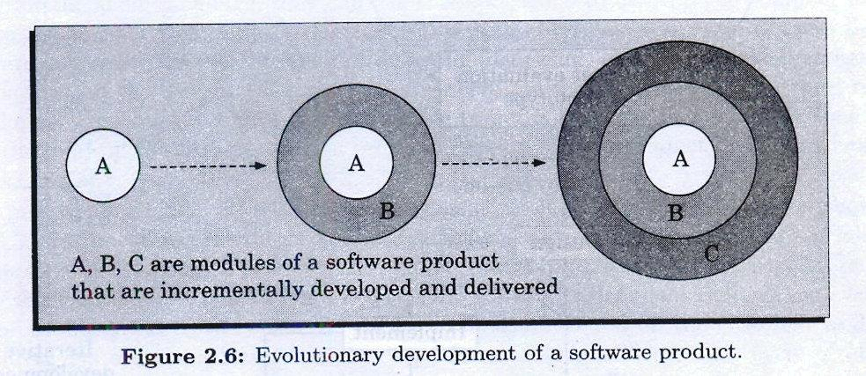
Evolutionary Model (CONT.)
C
A
A
A
B
B

Slide 59
Evolutionary Model
This model reduce risk
Incremental process may be incorporated rapidly.
Software requirements changes rapidly.Then this model is effective, when the client request for new system
Lack of understanding the project means, more no. of refinement, fill the system is accepted by the client.
Initially it seems that there is no technical solution,but refinement is required.

Slide 60
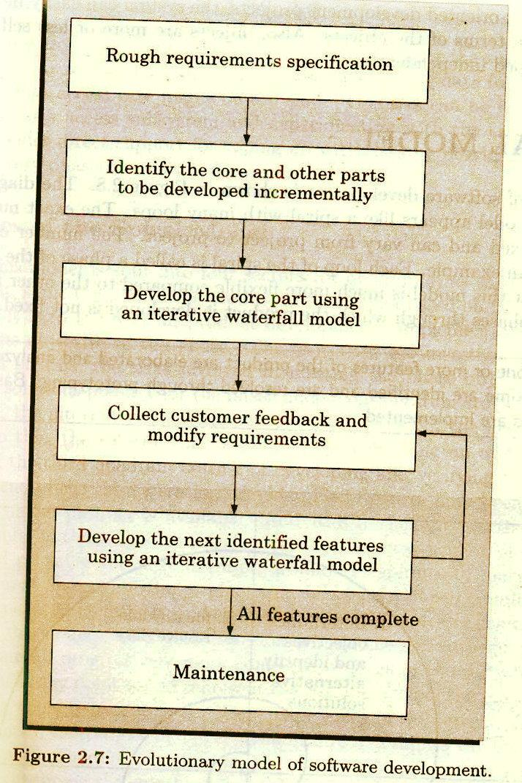

Slide 61
Advantages of Evolutionary Model
1. Users get a chance to experiment with a partially developed system:
much before the full working version is released,
2. Helps finding exact user requirements:
much before fully working system is developed.
3. Core modules get tested thoroughly:
reduces chances of errors in final product.
4. Effort for prototype is not wanted.
5. Faster than water fall model
6. High level interaction from the beginning.
7. Discovery of new methods may be involved

Slide 62
Disadvantages of Evolutionary Model
1.Often, difficult to subdivide problems into functional units:
which can be incrementally implemented and delivered.
evolutionary model is useful for very large problems,
where it is easier to find modules for incremental implementation.
2. Difficult to plan as amount of effort is uncertain
3. Documentation may be neglected
4. Poor structure coding.

Slide 63
Spiral Model
In spiral model activities are organized in the form of spiral. The spiral has many cycle.
Exact no of loops are not fixed
Each loop of the spiral represents a phase S/W process.
“Risk”: It is essentially any adverse circumstances that might hamper the successful completion of software project. Ex: Accessing data form a remote database can be that data access rate might be too slow. The risk can be resolved by building a prototype of the data access subsystem

Slide 64
Spiral Model
“Radius” of the spiral at any represents the cost incurred in the project till them.
“Angular Dimension” represents the progress made in the current phase.
It is called Meta Model
A SINGLE-LOOP spiral represents the waterfall model
It uses prototyping as a risk reduction mechanism.
The iterations along the spiral model can be considered as evolutionary level through which the complete system built.

Slide 65
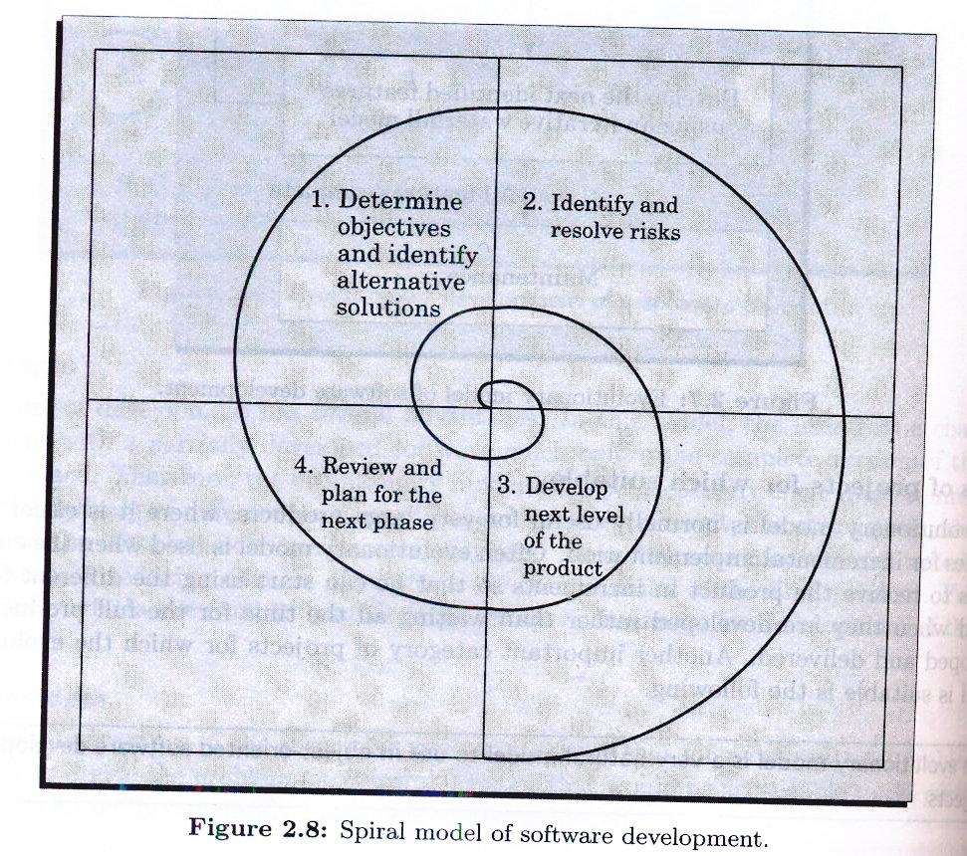
Spiral Model

Slide 66
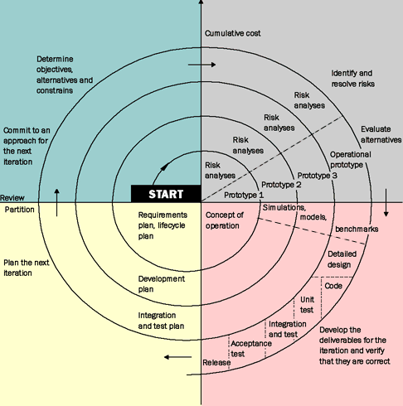

Slide 67
Spiral Model begins with…
Objective setting
Identifying alternatives
Risk assessment & reduction
Development & validation
Planning

Slide 68
Templates for a spiral round
Objective: Goal of the analysis
Constraints: Factors that limits possibilities.
Alternatives:Different ways to active objective
Risk: Analyzing the dangers associated with every alternatives.
Risk Reduction: Strategies incorporated to reduce the risk
Result:Outcome of risk reduction
Plan:How to approach to the next phase
Commitment:Management decision regarding continuation

Slide 69
Spiral Model
Advantages:
For high-risk project, this model may be better than any other model
Lead time means decision of top-level management
First level may be cancelled, and second cycle begins with new task

Slide 70
Spiral Model
Disadvantages:
At some extent spiral model is theoritical and hence not possible to follow it at all the phases.The program developers don’t like to adopt this model as the theoritical approach is not allways suitable with their practical work.

Slide 71
Spiral Model as a Meta Model
The spiral model is called a meta model since it encompasses all other life cycle models. Risk handling is inherently built into this model. The spiral model is suitable for development of technically challenging software products that are prone to several kinds of risks. However, this model is much more complex than the other models – this is probably a factor deterring its use in ordinary projects.

Slide 72
Comparison of different life-cycle models
The classical waterfall model can be considered as the basic model and all other life cycle models as embellishments of this model. However, the classical waterfall model cannot be used in practical development projects, since this model supports no mechanism to handle the errors committed during any of the phases.

Slide 73
Comparison of different life-cycle models…
This problem is overcome in the iterative waterfall model. The iterative waterfall model is probably the most widely used software development model evolved so far. This model is simple to understand and use. However, this model is suitable only for well-understood problems; it is not suitable for very large projects and for projects that are subject to many risks.

Slide 74
The prototyping model is suitable for projects for which either the user requirements or the underlying technical aspects are not well understood. This model is especially popular for development of the user-interface part of the projects.

Slide 75
The evolutionary approach is suitable for large problems which can be decomposed into a set of modules for incremental development and delivery. This model is also widely used for object-oriented development projects. Of course, this model can only be used if the incremental delivery of the system is acceptable to the customer.

Slide 76
The spiral model is called a meta model since it encompasses all other life cycle models. Risk handling is inherently built into this model. The spiral model is suitable for development of technically challenging software products that are prone to several kinds of risks. However, this model is much more complex than the other models – this is probably a factor deterring its use in ordinary projects.

Slide 77
Questions

Slide 78
Chapter 1: Introduction to Processes Objective Question: What are the three states in the basic process model? a) Running, Blocked, Waiting b) Running, Ready, Blocked c) Running, Sleeping, Blocked d) Waiting, Sleeping, Ready Subjective Question: Explain the concept of a process in an operating system and discuss the significance of process states. Chapter 2: Process Scheduling Objective Question: Which scheduling algorithm is considered non-preemptive? a) Round Robin b) Shortest Job Next c) Priority Scheduling d) Multilevel Queue Scheduling Subjective Question: Describe the role of the Process Control Block (PCB) in process management and scheduling.

Slide 79
Chapter 3: Inter-Process Communication (IPC) Objective Question: Which of the following is not an IPC mechanism? a) Pipes b) Shared Memory c) Paging d) Message Passing Subjective Question: Compare and contrast message passing and shared memory as IPC mechanisms. Discuss the advantages and disadvantages of each. Chapter 4: Process Synchronization Objective Question: What problem can arise in concurrent processes that share data? a) Deadlock b) Data Inconsistency c) Resource Starvation d) Both a and b Subjective Question: Explain the critical section problem in process synchronization and how semaphores can be used to solve it.

Slide 80
Chapter 5: Deadlock Objective Question: Which of the following is NOT a condition for deadlock? a) Mutual Exclusion b) Hold and Wait c) Circular Wait d) Time Sharing Subjective Question: Discuss the strategies for handling deadlocks in an operating system. How can deadlocks be prevented, avoided, detected, or recovered from? Chapter 6: Process States Transition Objective Question: In the process state transition diagram, what transition occurs when a process moves from the running state to the blocked state? a) Process yields CPU voluntarily b) Process completes its execution c) Process requests I/O d) Process is preempted by the scheduler Subjective Question: Describe the significance of each state in a process's lifecycle and provide examples of events that might trigger state transitions.

